Slide 1
COMP 2230
Week 9 - Monday

Slide 2
Last time
Exam 2 post mortem

Slide 3
Questions?

Slide 4
Assignment 4

Slide 5
Logical warmup
You need to pack for a midnight flight to Iceland but the power is out.
In your closet are six pairs of shoes, six black socks, six gray socks, six pairs of brown gloves, and six pairs of tan gloves.
Unfortunately, it's too dark to match shoes or to see any colors.
How many of each of these items do you need to take to be sure of getting a matched pair of shoes, two socks of the same color, and gloves that match each other?

Slide 6
Multiplication Rule

Slide 7
Possibility trees
We can use a tree to represent all the possibilities in a situation
Example:
  Teams A and B are playing a best of 3 tournament
  The first team to win 2 games wins
  How likely is it that 3 games are needed to decide the tournament, assuming that all ways of playing the tournament are equally likely (which is not a reasonable assumption)?
A
A
A
B
B
A
B
A
B
B

Slide 8
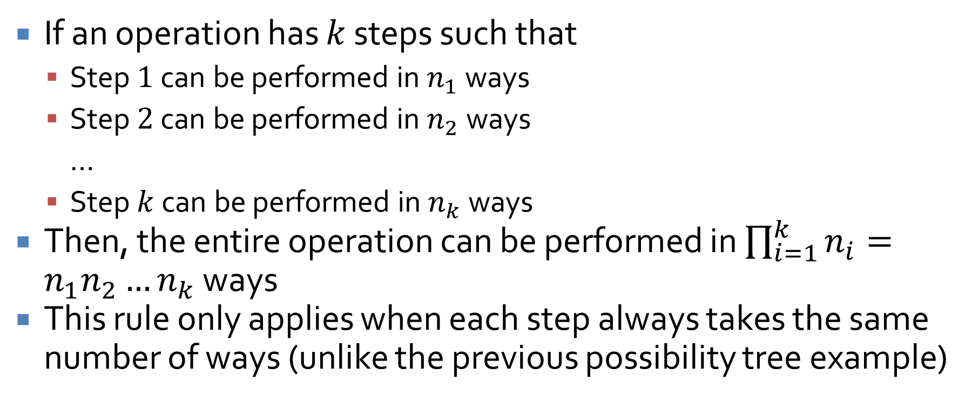
Multiplication rule
If an operation has $k$ steps such that
  Step $1$ can be performed in $n_{1}$ ways
  Step $2$ can be performed in $n_{2}$ ways
  …
  Step $k$ can be performed in $n_{k}$ ways
Then, the entire operation can be performed in $\prod_{i=1}^{k}{n_{i}}=n_{1}n_{2}…n_{k}$ ways
This rule only applies when each step always takes the same number of ways (unlike the previous possibility tree example)

Slide 9

Coin example
If you flip a coin $k$ times, how many total possibilities are there for the outcomes?

Slide 10
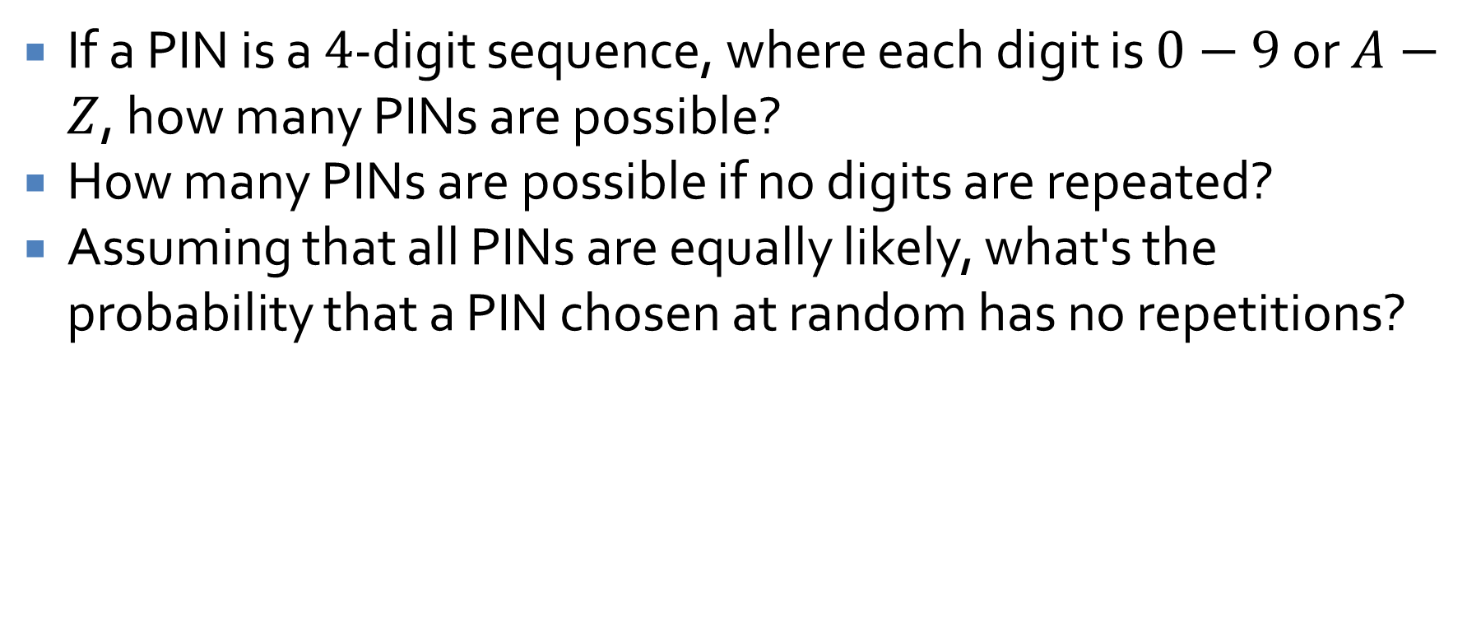
Personal Identification Numbers
If a PIN is a $4$-digit sequence, where each digit is $0−9$ or $A−Z$, how many PINs are possible?
How many PINs are possible if no digits are repeated?
Assuming that all PINs are equally likely, what's the probability that a PIN chosen at random has no repetitions?

Slide 11
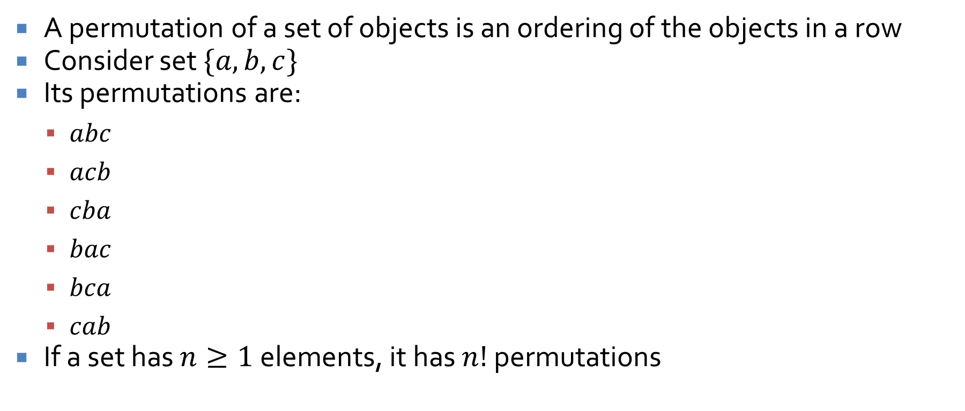
Permutations
A permutation of a set of objects is an ordering of the objects in a row
Consider set $\{a, b, c\}$
Its permutations are:
  $abc$
  $acb$
  $cba$
  $bac$
  $bca$
  $cab$
If a set has $n≥1$ elements, it has $n!$ permutations

Slide 12
Permutations of letters in a word
How many different ways can the letters in the word "WOMBAT" be permuted?
How many different ways can "WOMBAT" be permuted such that "BA" remains together?
What is the probability that, given a random permutation of "WOMBAT", the "BA" is together?
How many different ways can the letters in "MISSISSIPPI" be permuted?
How many would it be if we don't distinguish between copies of letters?

Slide 13
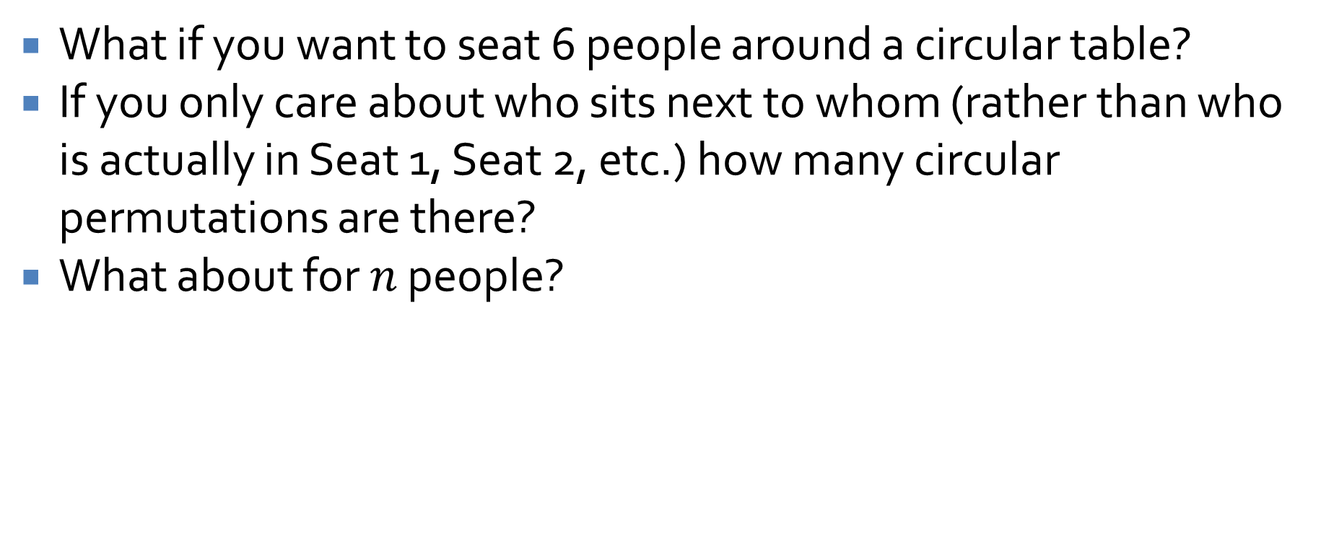
Permuting around a circle
What if you want to seat 6 people around a circular table?
If you only care about who sits next to whom (rather than who is actually in Seat 1, Seat 2, etc.) how many circular permutations are there?
What about for $n$ people?

Slide 14
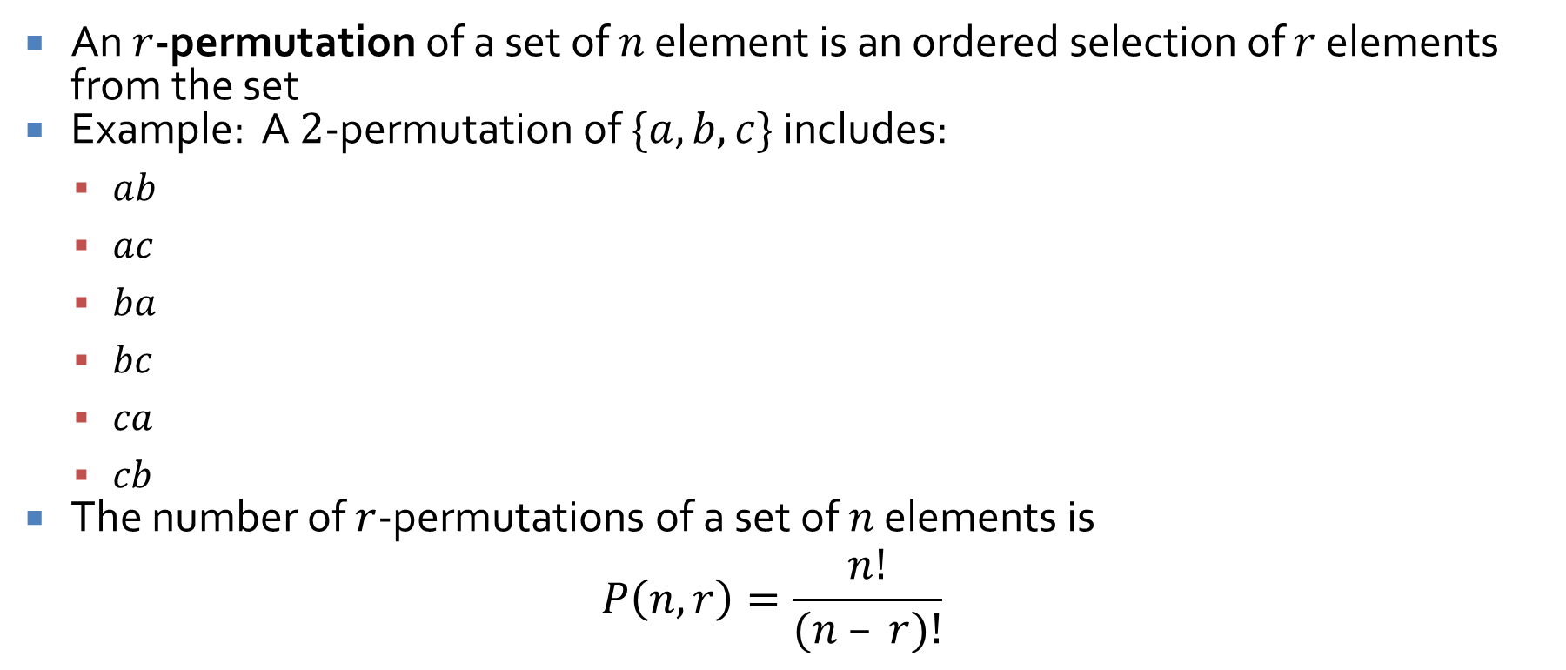
Permutations of selected elements
An $r$-permutation of a set of $n$ element is an ordered selection of $r$ elements from the set
Example: A $2$-permutation of $\{a, b, c\}$ includes:
  $ab$
  $ac$
  $ba$
  $bc$
  $ca$
  $cb$
The number of $r$-permutations of a set of $n$ elements is
$$P\left(n,r\right)=\frac{n!}{(n – r)!}$$

Slide 15


$r$-permutation examples
What is $P(5,2)$?
How many $4$-permutations are there in a set of $7$ objects?
How many different ways can three of the letters in "BYTES" be written in a row?

Slide 16
Disjoint Sets

Slide 17

Addition rule
If a finite set $A$ equals the union of $k$ distinct mutually disjoint subsets $A_{1}$, $A_{2}$, … $A_{k}$, then:
$N(A) = N(A_{1}) + N(A_{2}) + … + N(A_{k})$

Slide 18
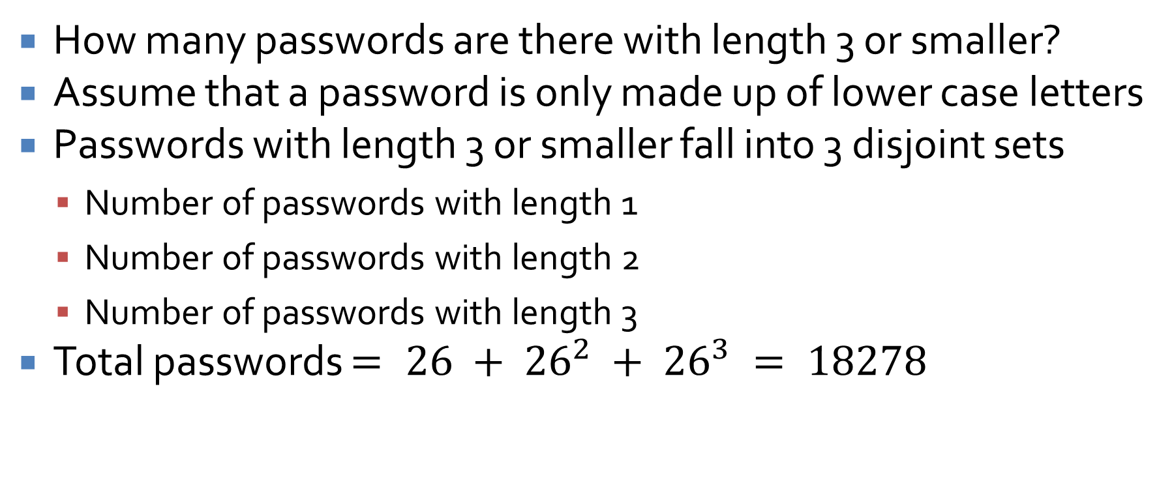
Addition rule example
How many passwords are there with length 3 or smaller?
Assume that a password is only made up of lower case letters
Passwords with length 3 or smaller fall into 3 disjoint sets
  Number of passwords with length 1
  Number of passwords with length 2
  Number of passwords with length 3
Total passwords $= 26 + {26}^{2} + {26}^{3} = 18278$

Slide 19
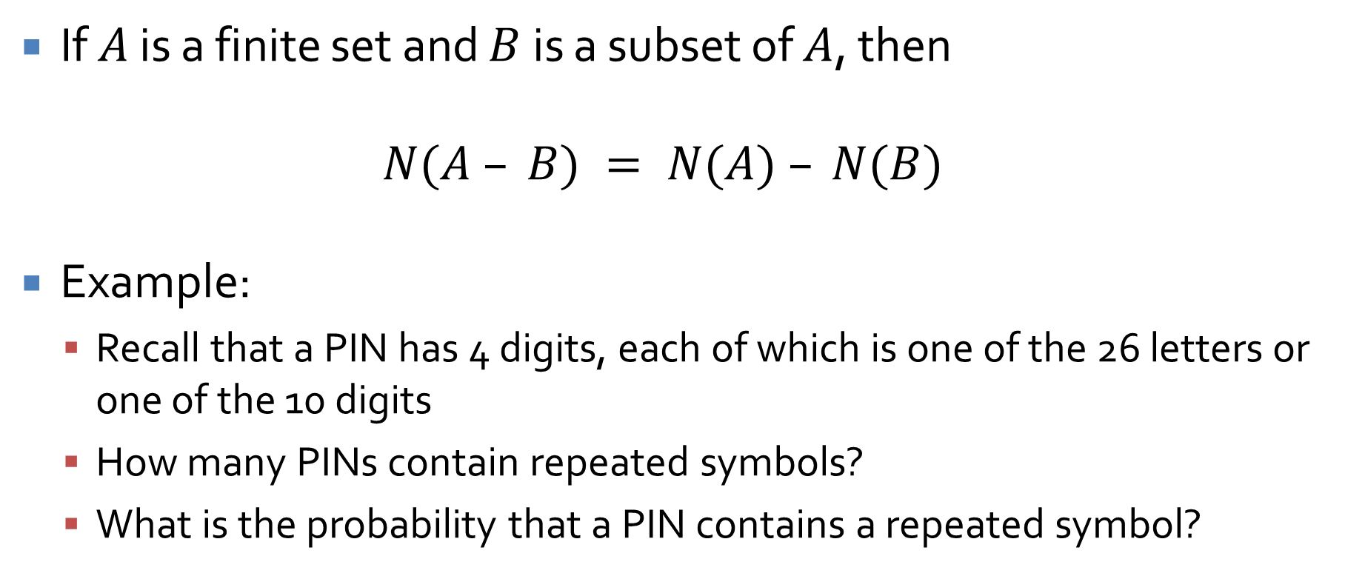
Difference rule
If $A$ is a finite set and $B$ is a subset of $A$, then
$$N(A – B) = N(A) – N(B)$$
Example:
  Recall that a PIN has 4 digits, each of which is one of the 26 letters or one of the 10 digits
  How many PINs contain repeated symbols?
  What is the probability that a PIN contains a repeated symbol?

Slide 20
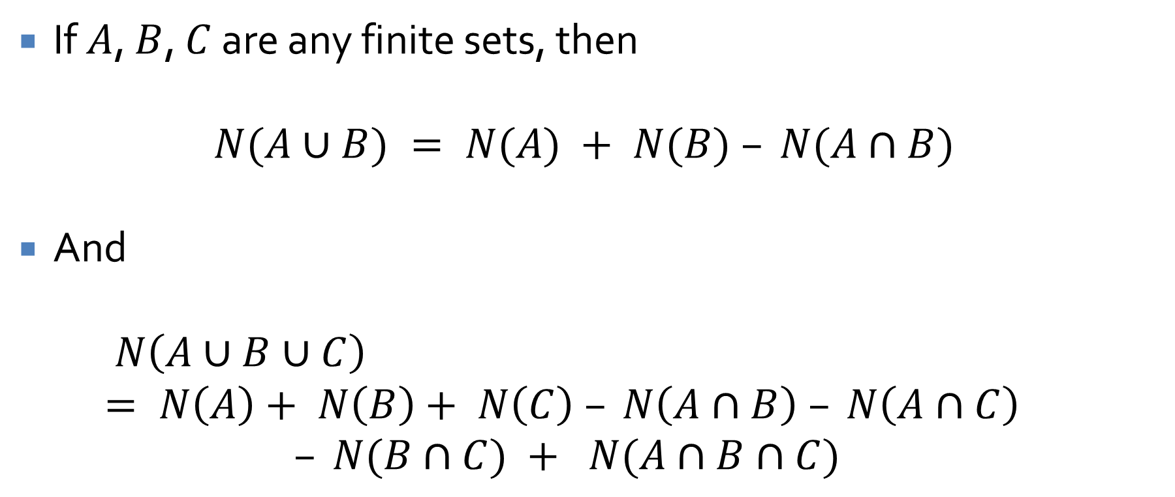
Inclusion/exclusion rule
If $A$, $B$, $C$ are any finite sets, then
$$N(A∪B) = N(A) + N(B) – N(A∩B)$$
And
$$N\left(A∪B∪C\right)= N\left(A\right)+ N\left(B\right)+ N\left(C\right) – N\left(A∩B\right) – N\left(A∩C\right)$$
$$– N(B∩C) + N(A∩B∩C)$$

Slide 21
Inclusion exclusion example
How many integers from 1 through 1,000 are multiples of 3 or multiples of 5?
How many integers from 1 through 1,000 are neither multiples of 3 nor multiples of 5?

Slide 22
Inclusion exclusion example
Consider a survey of 50 students about the programming languages they know
The results are:
  30 know Java
  18 know C++
  26 know ML
  9 known both Java and C++
  16 know both Java and ML
  8 know both C++ and ML
  47 know at least one of the three
How many students know none of the three?
How many students know all three?
How many students know Java and C++ but not ML?
How many students know Java but neither C++ nor ML?

Slide 23
Pigeonhole Principle

Slide 24
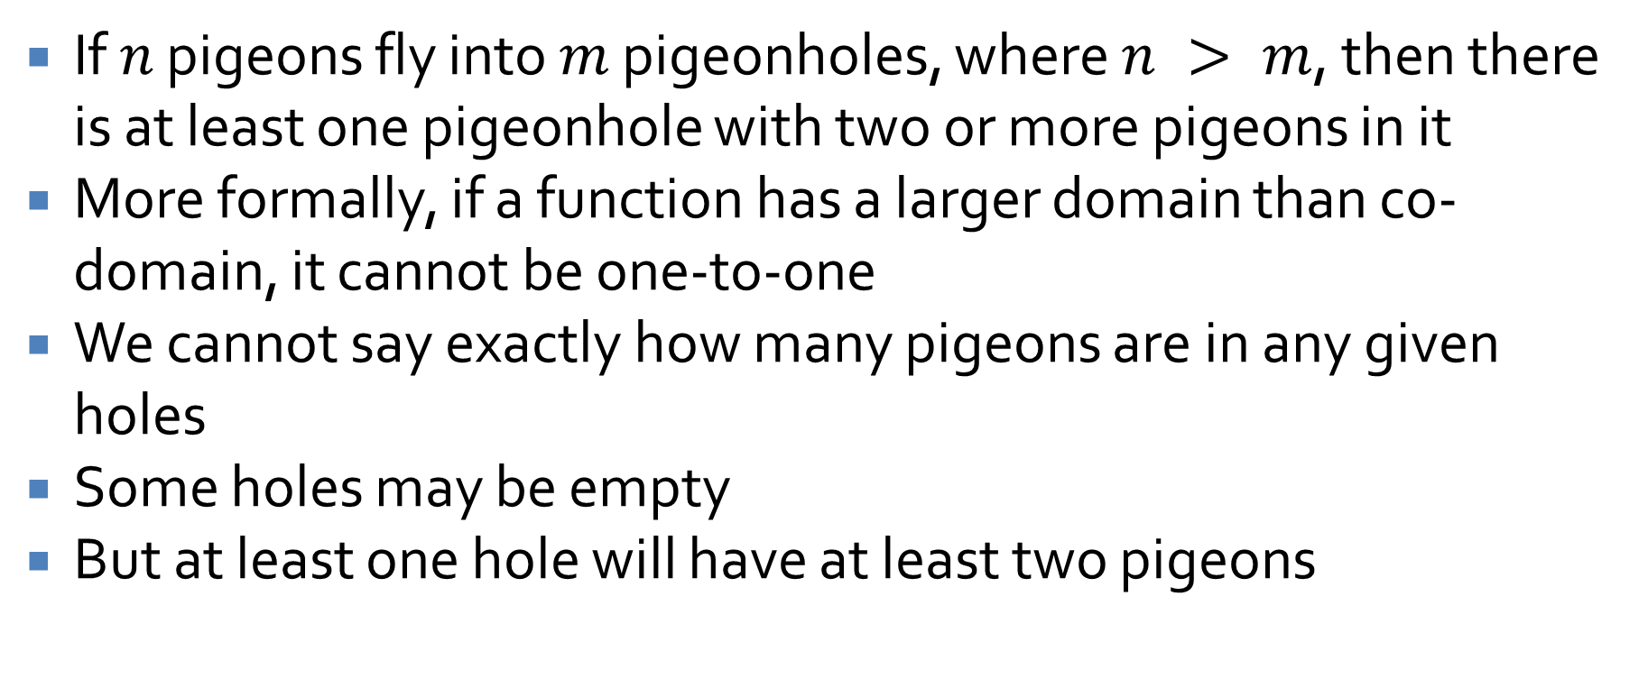
Pigeonhole principle
If $n$ pigeons fly into $m$ pigeonholes, where $n > m$, then there is at least one pigeonhole with two or more pigeons in it
More formally, if a function has a larger domain than co-domain, it cannot be one-to-one
We cannot say exactly how many pigeons are in any given holes
Some holes may be empty
But at least one hole will have at least two pigeons

Slide 25
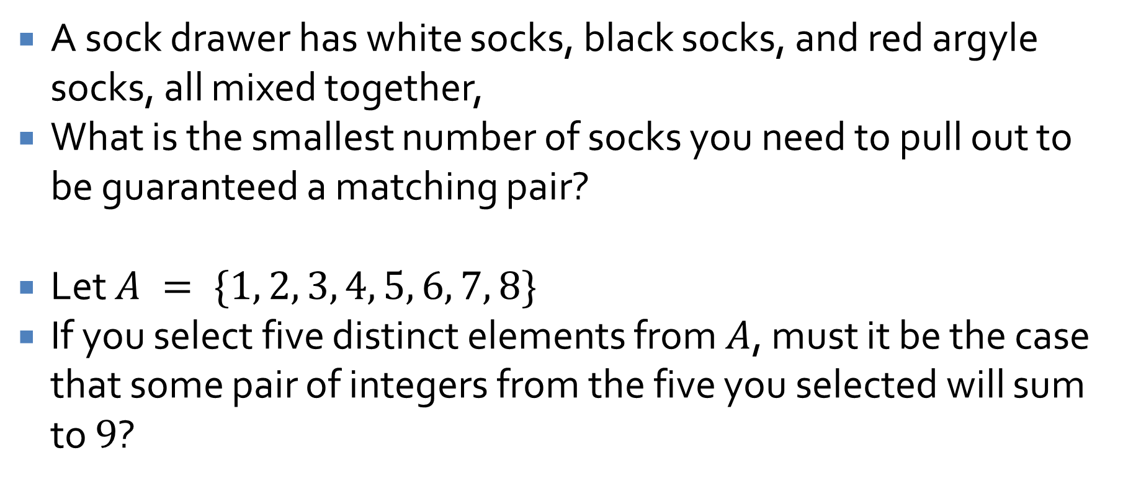
Pigeonhole examples
A sock drawer has white socks, black socks, and red argyle socks, all mixed together,
What is the smallest number of socks you need to pull out to be guaranteed a matching pair?
Let $A = \{1, 2, 3, 4, 5, 6, 7, 8\}$
If you select five distinct elements from $A$, must it be the case that some pair of integers from the five you selected will sum to $9$?

Slide 26
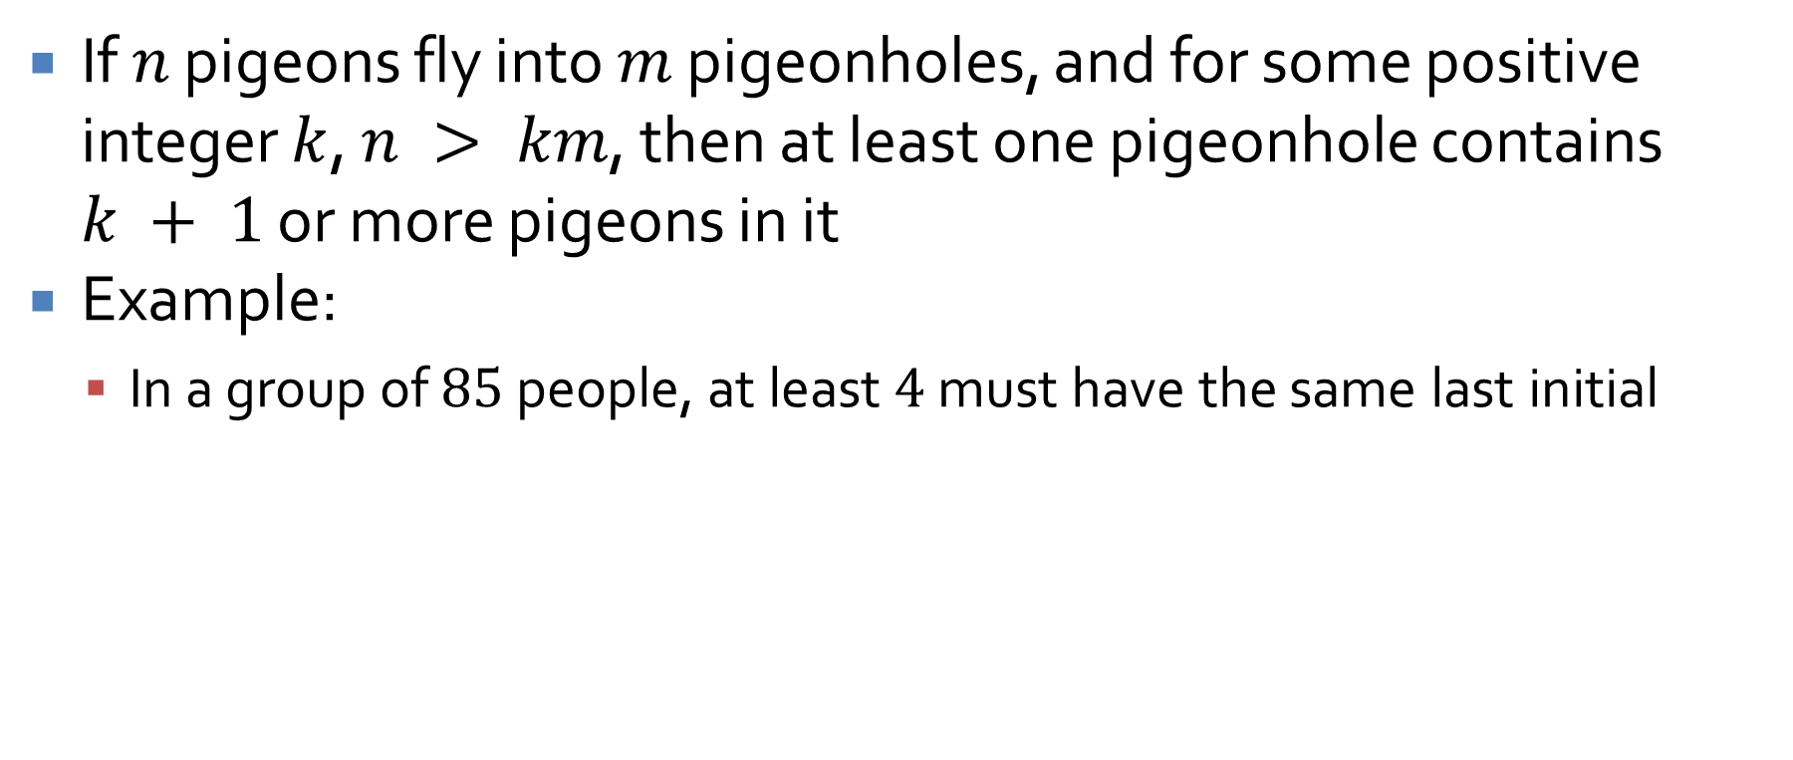
Generalized pigeonhole principle
If $n$ pigeons fly into $m$ pigeonholes, and for some positive integer $k$, $n > km$, then at least one pigeonhole contains $k + 1$ or more pigeons in it
Example:
  In a group of $85$ people, at least $4$ must have the same last initial

Slide 27
Combinations and Combinations with Repetition
Three-sentence summary

Slide 28
Upcoming

Slide 29
Next time…
Combinations
Combinations with repetition
Binomial theorem and Pascal's triangle
Expected value

Slide 30
Reminders
Keep working on Assignment 4
Read 9.7 and 9.8
  Prepare a three-sentence summary
  Extra credit if you get called on

